Slide 1


COGNIZANT Internship Program QEA- Automation Testing With UFT and HC FACETS INTQEA22HC003 - TEAM 3 HACKATHON CASE STUDY – identify Car Wash SERVICEs
Team members:
Sudipta das
Ryan das
Sowmiya t
Kannu priya
Mritunjay kumar pandey

Slide 2

Hackathon description
PROBLEM STATEMENT | DETAILED DISCRIPTION
Display 5 Car washing services name and phone numbers 1. Car washing services near you with highest rating on top. 2. Customer Votes should be more than 20 (Suggested Site: justdial.com however you are free to choose any other legitimate site) | 1. Display 5 Car washing services name and phone numbers, near your location with highest rating (more than 4) on top & Customer Votes more than 20. 2. Try to register for Free Listing, fill the form with any one input invalid (example: phone); Capture the error message & display . 3. From Fitness, go to Gym and retrieve all sub-menu items and store in a List; Display the same.
SITE USED : Justdial.com SEARCH ENGINE USED: chrome.exe

Slide 3

Work flow
Understanding
Understanding description and deciding execution
Launching
Launching UFT one platform
Recording
Recording the description and using descriptive programing
Displaying
Displaying required credentials by fulfilling conditions
Closing
Closing the browser

Slide 4
Test flow
The whole test case divided into three parts
Displaying car wash services
Registering for "free listing" using invalid input data (phone number)
Retrieve all sub menu items from Fitness section and displaying them

Slide 5
Display car wash services
Opening the browser and selecting location as Chennai
Entering search string
After search results are displayed select rating as higher
Verify 5 car wash services with rating more than 4 and customer votes more than 20
Display the 5 car wash services in console

Slide 6
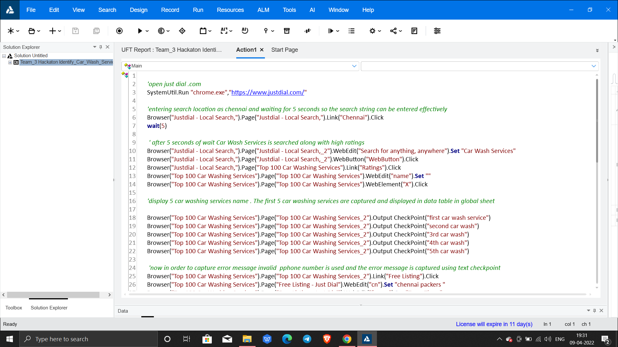
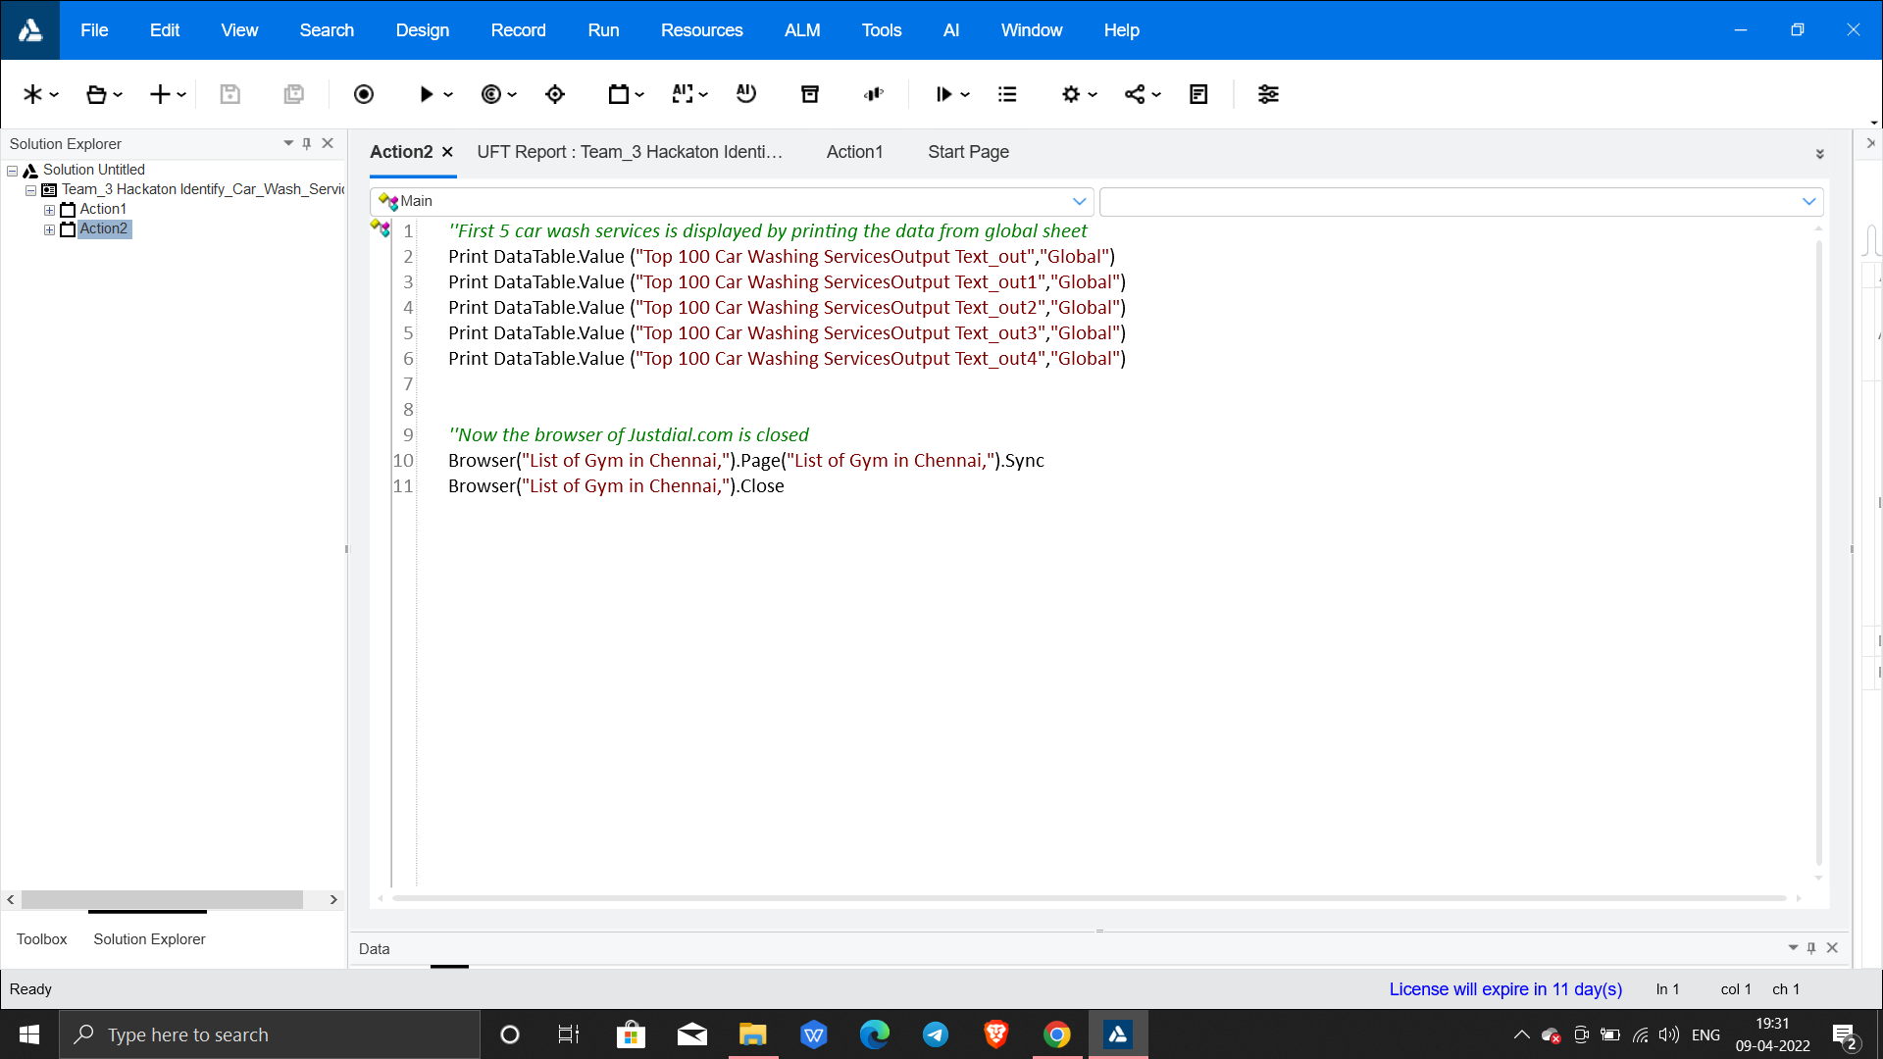
Captured car wash services is displayed from the data stored in global sheet
Code to capture 5 car wash services

Slide 7
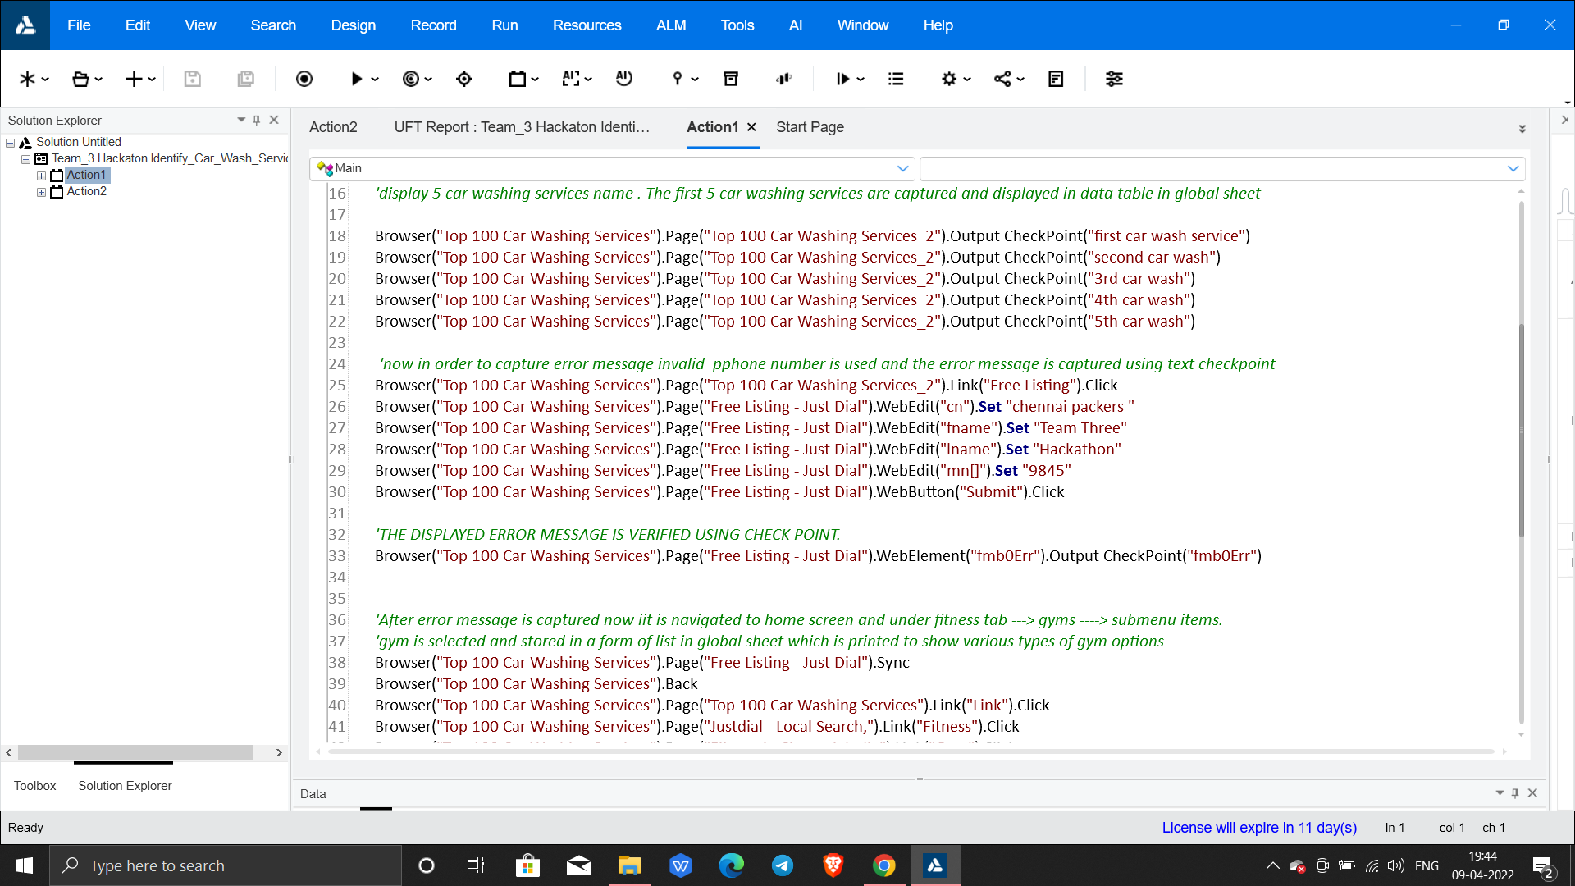
Registering using invalid data
Select free listing
Enter valid data in all fields except phone number
Error message is displayed
Verify if error message is displayed

Slide 8
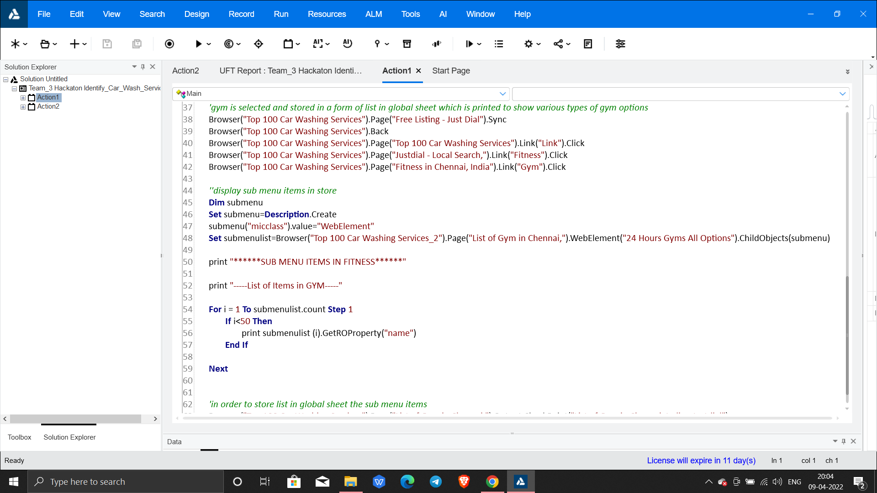
Display sub-menu items
Go back to home page of justdial.com
1
Select fitness section in homepage
2
Under Fitness section select Gym option
3
Verify whether Sub-menu items are displayed and print them in console
4

Slide 9
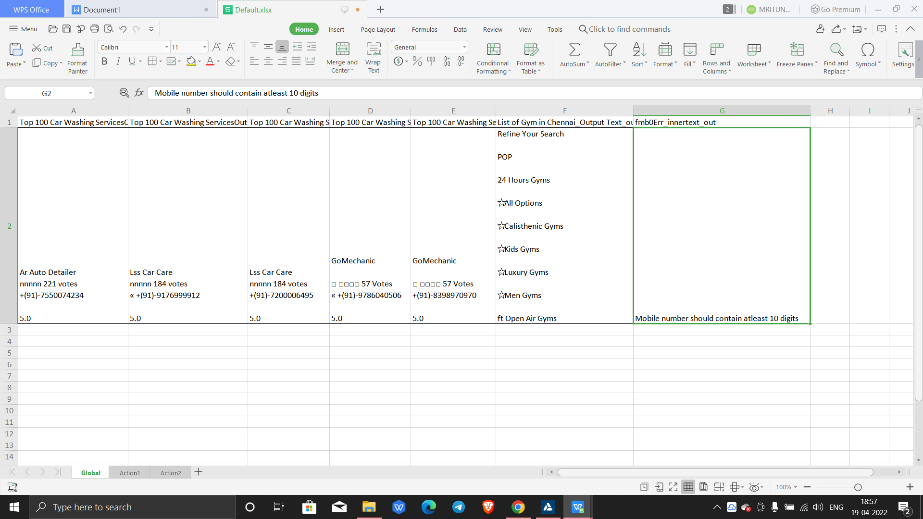
Data in global sheet

Slide 10


